Slide 1
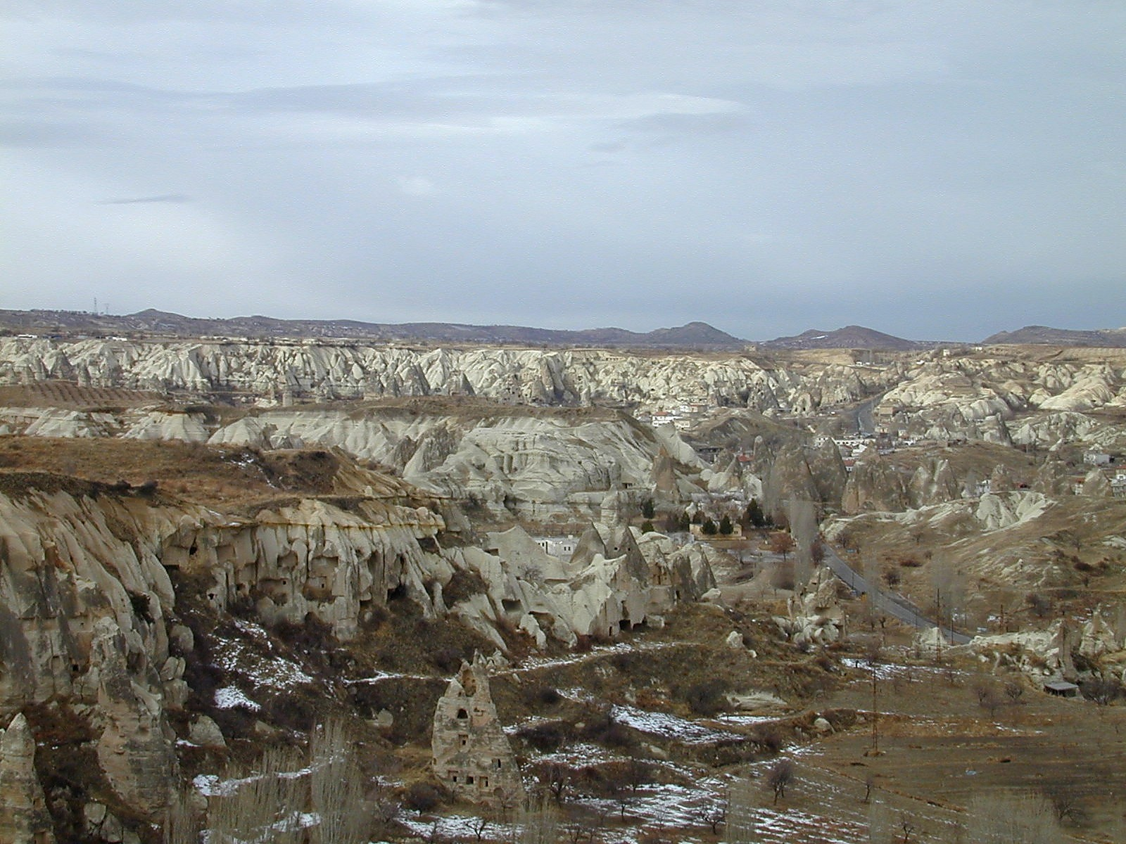
1 Peter 1.13-2.3
Responding to God’s Promise
Goreme Valley in Cappadocia
This photo is from the collection "Pictorial Library of Bible Lands, volumes 1-10," © 2006 by Todd Bolen, BiblePlaces.com

Slide 2
Because we have this promise of deliverance out of suffering and into a glorious inheritance...
A. We must place all our hope in God’s grace.
1 Peter 1.13 NET: Therefore, get your minds ready for action by being fully sober, and set your hope completely on the grace that will be brought to you when Jesus Christ is revealed.

Slide 3
93% study the Bible during the week.
41% study five days or more each week.
17% are actively memorizing scripture.
31% have memorized many passages.
69% read or listen to other theological teachings.

Slide 4
Because we have this promise of deliverance out of suffering and into a glorious inheritance...
B. We must become pure and obedient to God.
1.14-16: Like obedient children, do not comply with the evil urges you used to follow in your ignorance, but, like the Holy One who called you, become holy yourselves in all of your conduct, for it is written, "You shall be holy, because I am holy."

Slide 5
Because we have this promise of deliverance out of suffering and into a glorious inheritance...
C. We must show reverence to God at all times.
1.17-21: ... live out the time of your temporary residence here in reverence. You know that from your empty way of life inherited from your ancestors you were ransomed... by precious blood like that of an unblemished and spotless lamb, namely Christ... Through him you now trust in God... so that your faith and hope are in God.

Slide 6
Because we have this promise of deliverance out of suffering and into a glorious inheritance...
D. We must love others sincerely and fervently.
1.22-25: ... So love one another earnestly from a pure heart. You have been born anew, not from perishable but from imperishable seed, through the living and enduring word of God. For all flesh is like grass and all its glory like the flower of the grass; the grass withers and the flower falls off, but the word of the Lord endures forever. And this is the word that was proclaimed to you.

Slide 7
Because we have this promise of deliverance out of suffering and into a glorious inheritance...
E. We must focus on getting nourished by God.
2.1-3: So get rid of all evil and all deceit and hypocrisy and envy and all slander. And yearn like newborn infants for pure, spiritual milk, so that by it you may grow up to salvation, if you have experienced the Lord's kindness.

Slide 8
1 Peter 1.13-2.3
Responding to God’s Promise
Goreme Valley in Cappadocia
This photo is from the collection "Pictorial Library of Bible Lands, volumes 1-10," © 2006 by Todd Bolen, BiblePlaces.com

